Slide 1



Inventory Optimization System

Slide 2
ABSTRACT
The Inventory Optimization System is a structured MySQL Workbench project designed to improve inventory management by minimizing overstock and stockouts. It models real-world processes using five normalized tables: Products, Suppliers, Inventory, Orders and PurchaseOrders. Through queries, joins, subqueries and views. The system enables better forecasting, supplier management and inventory control. Using a snowflake schema, it supports efficient data analysis and smarter decision-making. This project showcases database design and advanced SQL skills for real-world business applications.

Slide 3
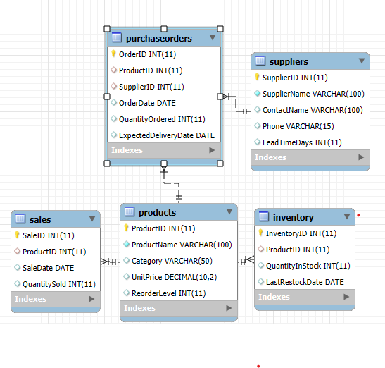
EER – Diagram

Slide 4
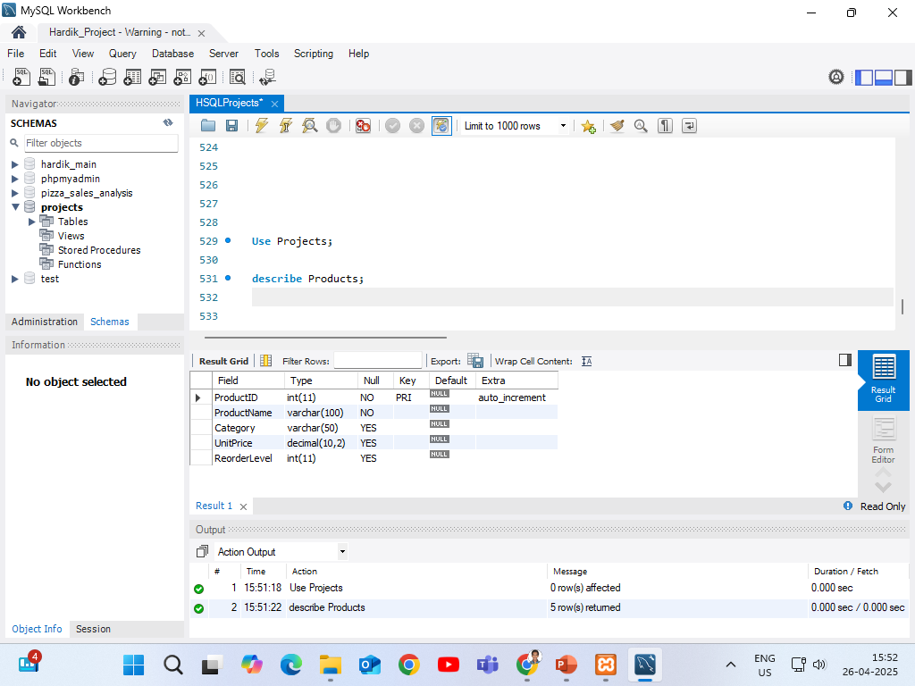
SCHEMA For Products Table

Slide 5
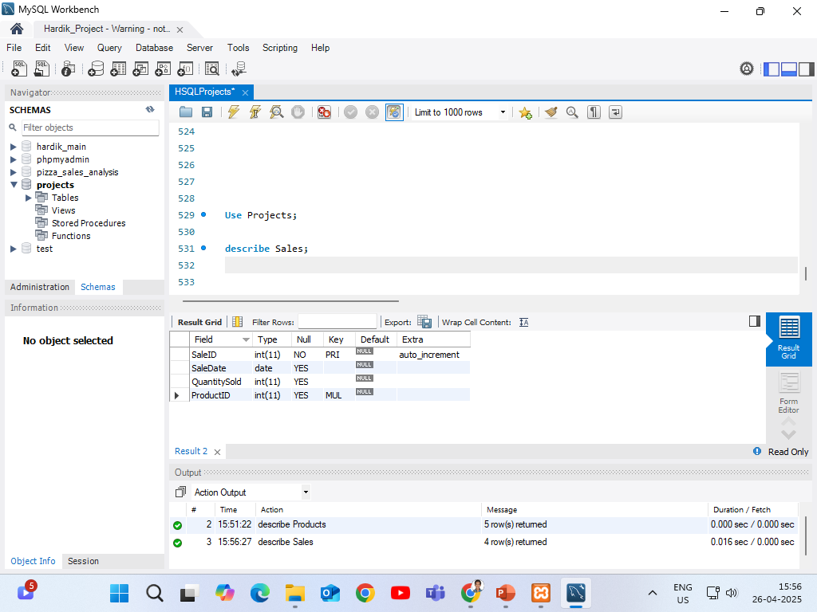
SCHEMA For Sales Table

Slide 6

SCHEMA For Inventory Table

Slide 7

SCHEMA For Suppliers Table

Slide 8
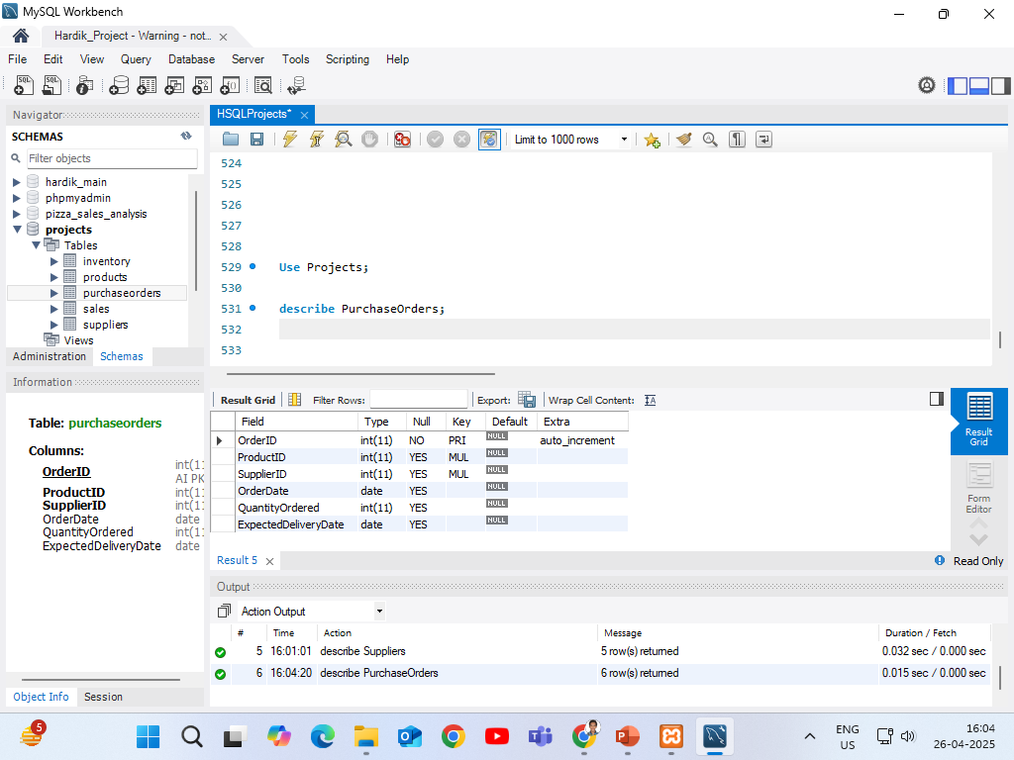
SCHEMA For PurchaseOrders Table

Slide 9
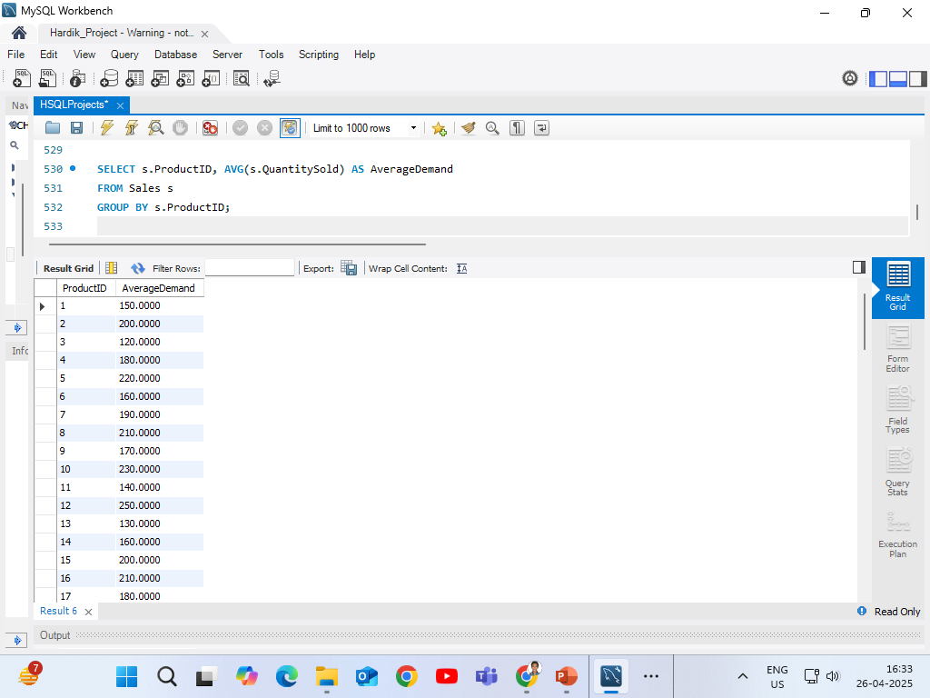
Average Demand Calculation (From Sales)
This query calculates the average quantity sold for each product across all sales records. It helps in understanding the typical demand level of each product by using the AVG() function grouped by ProductID.
Finds the average quantity sold per product → Helps predict future demand!

Slide 10
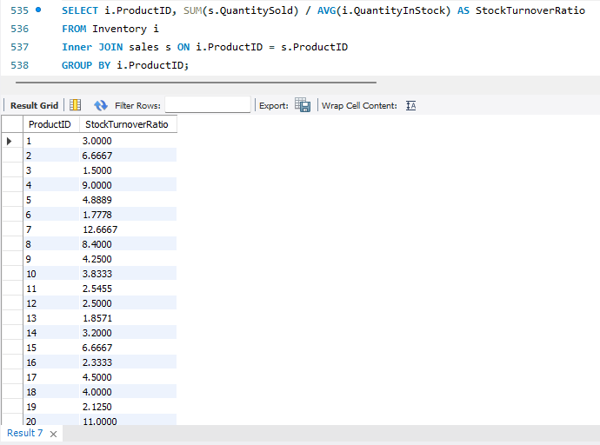
Stock Turnover Calculation (Inventory + Sales)
This query measures inventory efficiency by calculating the stock turnover ratio for each product using a join between Sales and Inventory data.
Shows how fast stock is moving based on sales and inventory.

Slide 11
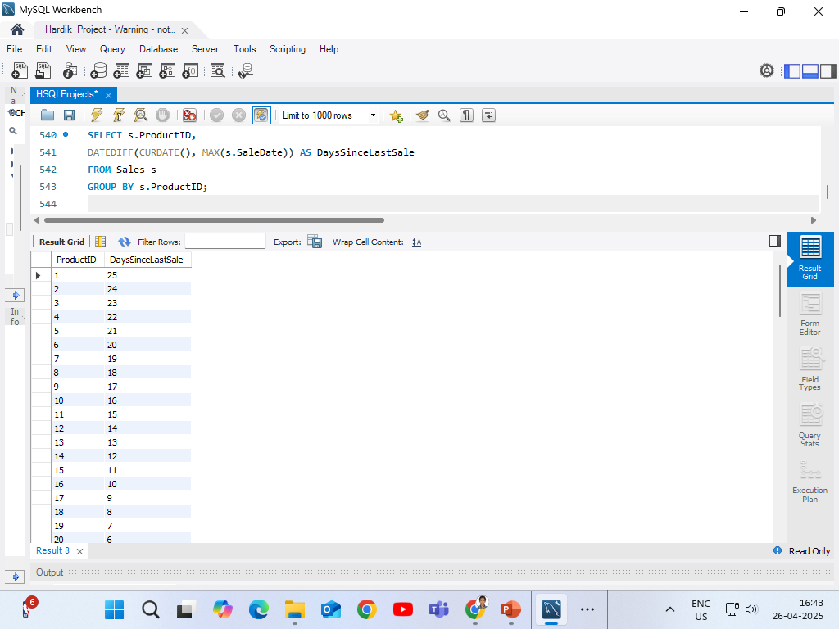
Days Since Last Sale
This query calculates the number of days since each product was last sold to help identify slow-moving items.
Helps find products that haven’t been sold recently → maybe slow-moving stock!

Slide 12

Days Since Last Purchase Order
This query calculates how many days have passed since the last purchase order was placed for each product, helping track restocking activity.
Tracks when was the last time you reordered stock from a supplier.

Slide 13
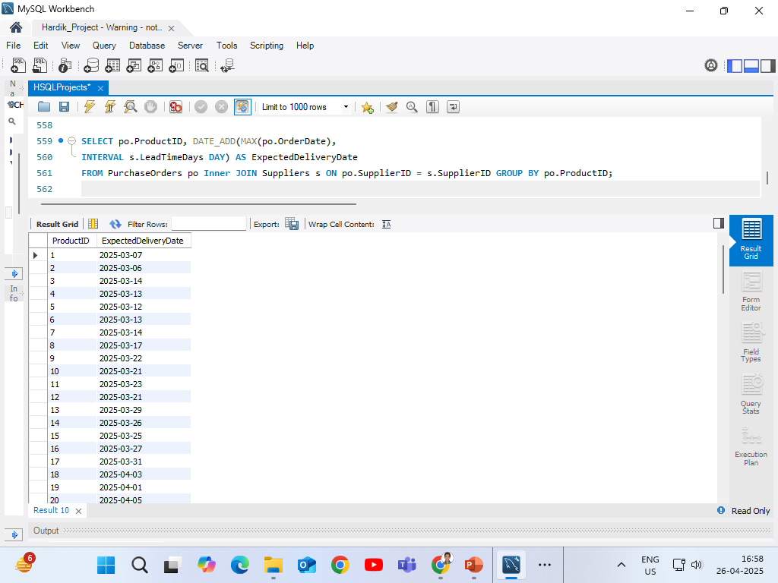
Predict Next Delivery Date Based on Supplier Lead Time
This query estimates the expected delivery date for each product by adding the supplier’s lead time to the latest purchase order date.
Predicts when the next batch of stock will arrive, adding lead time.

Slide 14
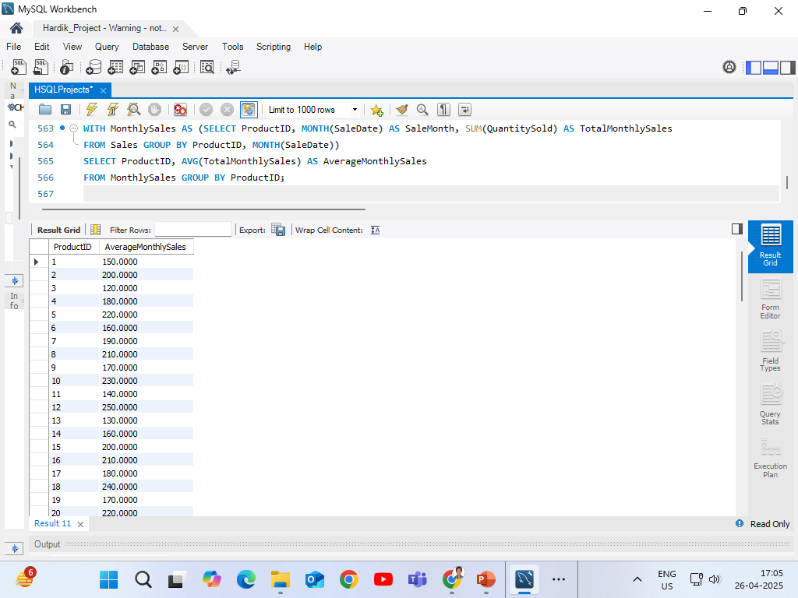
CTE to Create Monthly Sales Report
This query calculates the average monthly sales for each product by first summarizing the total sales per product and month, and then averaging those totals across all months.
Makes a clean CTE of monthly sales and then averages it for easy analysis!

Slide 15
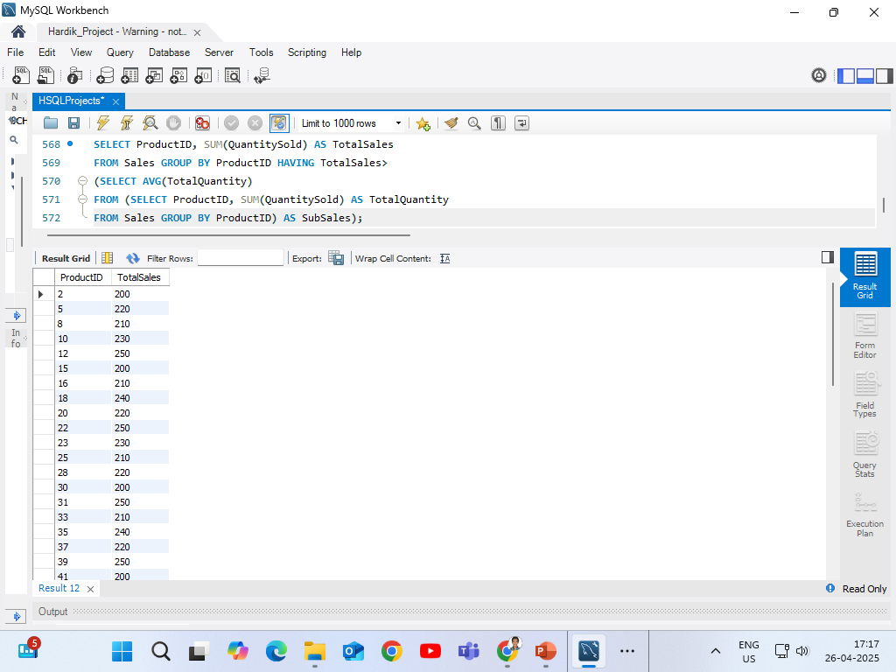
Find Products with Sales Above Average
SubQuery - 1
To identify which products are performing better than the average in sales, so I can prioritize their inventory management and avoid stockouts.
Find top-performing products compared to average sales.

Slide 16
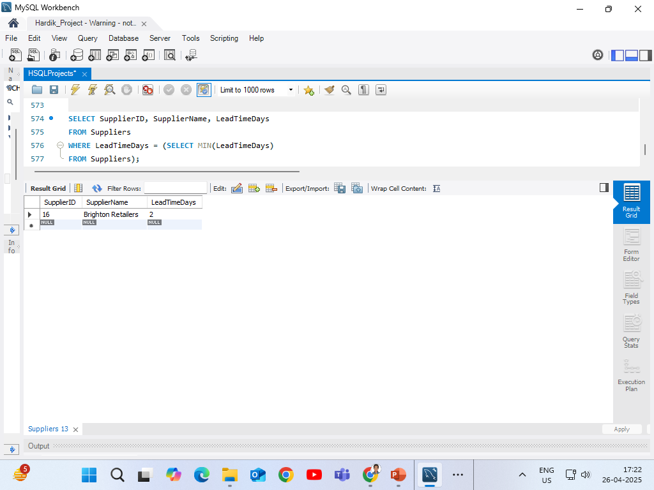
Find Suppliers with Minimum Lead Time
SubQuery - 2
To find the suppliers who deliver fastest, so I can prefer them for urgent inventory replenishment decisions.
Identify fastest suppliers based on lead time.

Slide 17
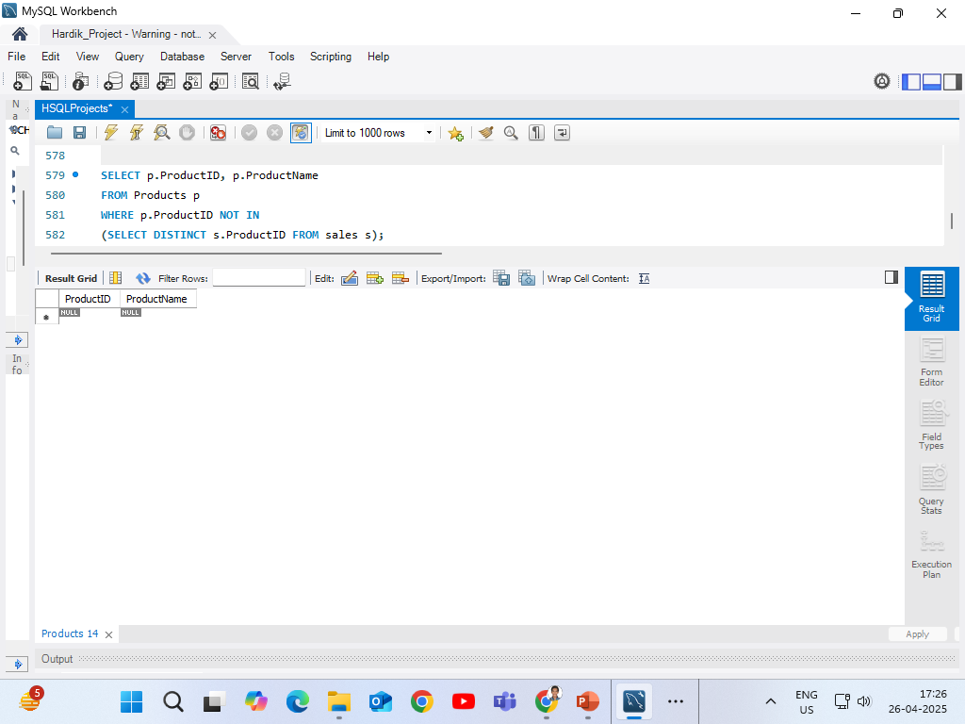
Products That Were Never Sold
SubQuery - 3
To detect products that were added into stock but never sold, so that I can plan clearance sales or revise purchasing strategy.
Detect dead stock products with zero sales.

Slide 18
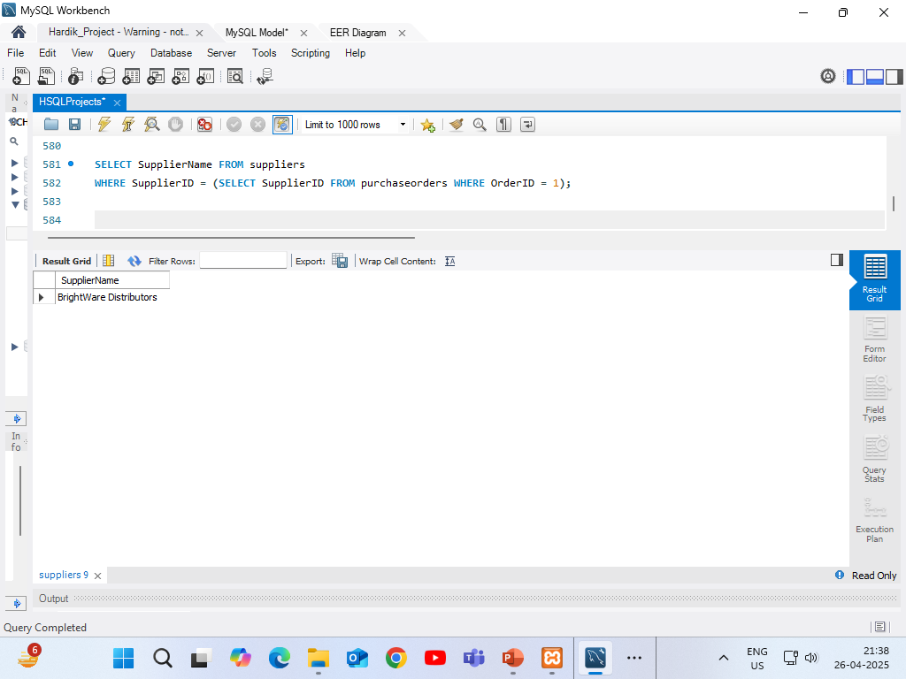
Used to fetch a single value (SupplierID) from a sub-query, allowing us to match it against another table (suppliers).
SubQuery – 4 (Single-row Sub-query)
Retrieves the name of the supplier for a specific purchase order.

Slide 19
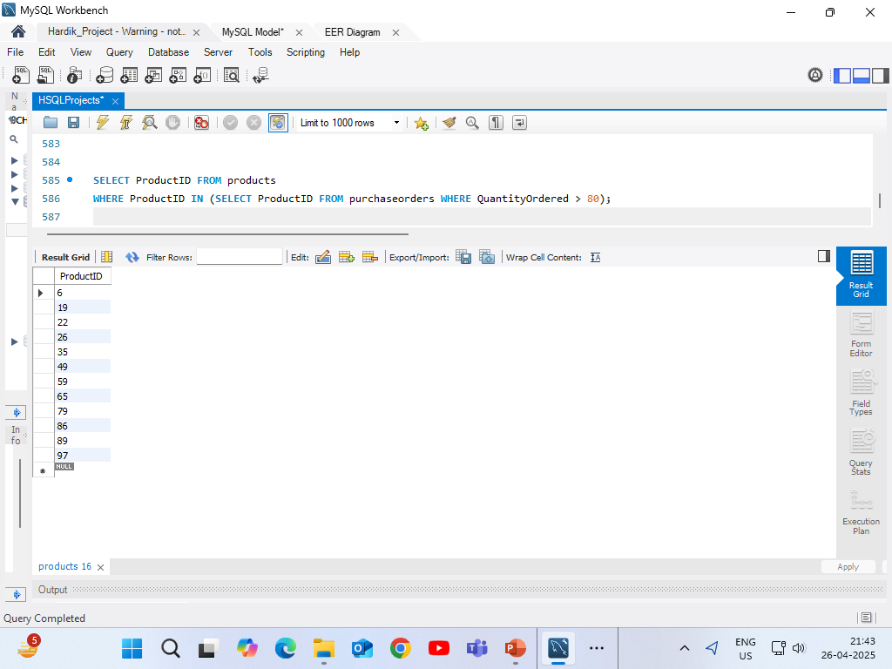
Allows for checking against multiple possible values returned from the sub-query (ProductIDs with more than 80 ordered).
SubQuery – 5 (Multi-row Sub-query)
Identifies product IDs with a substantial quantity ordered.

Slide 20
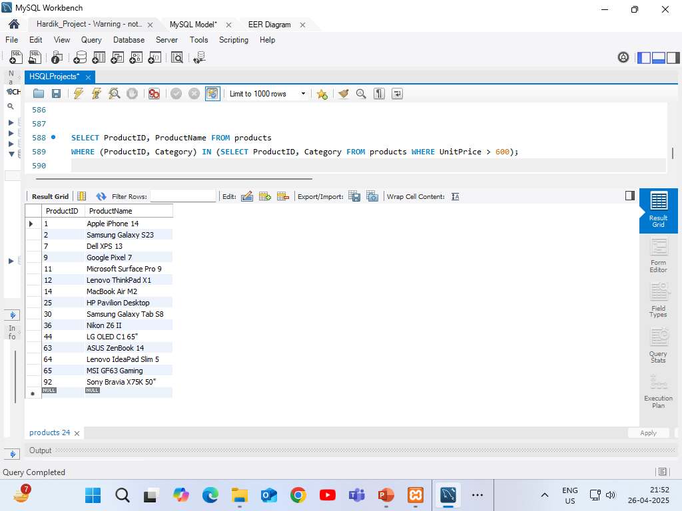
This allows for matching multiple columns across tables, providing more context in selections.
SubQuery – 6 (Multi-column Sub-query)
Fetches product details based on high-priced product categories.

Slide 21
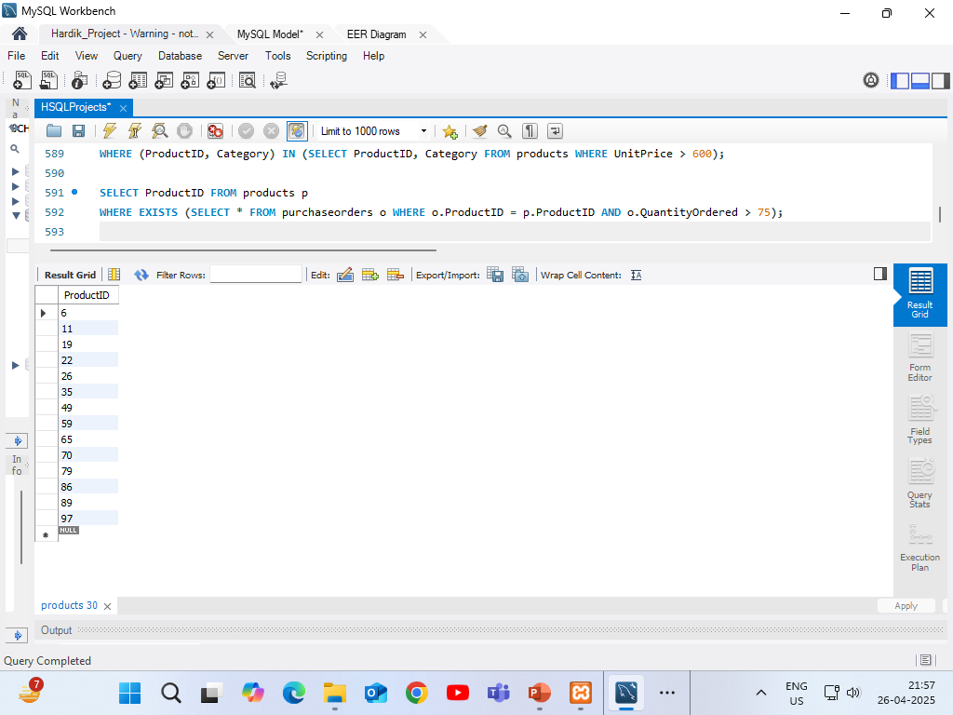
The sub-query references the outer query, checking for conditions that involve data from both.
SubQuery – 7 (Correlated Sub-query)
Finds products that have been ordered in quantities exceeding 75.

Slide 22
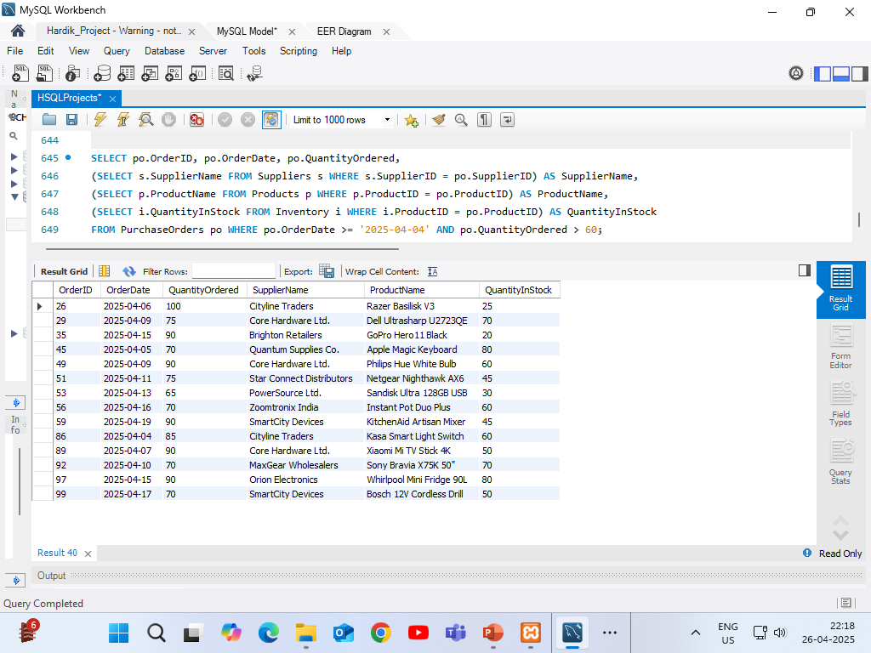
This query fetches purchase orders placed on or after April 4, 2025, with an ordered quantity greater than 50 units. It uses single-row subqueries to retrieve the corresponding supplier name, product name, and current inventory for each order.
SubQuery – 8 (Nested Sub-query)
Fetches detailed information for recent large purchase orders including supplier, product and current stock.

Slide 23
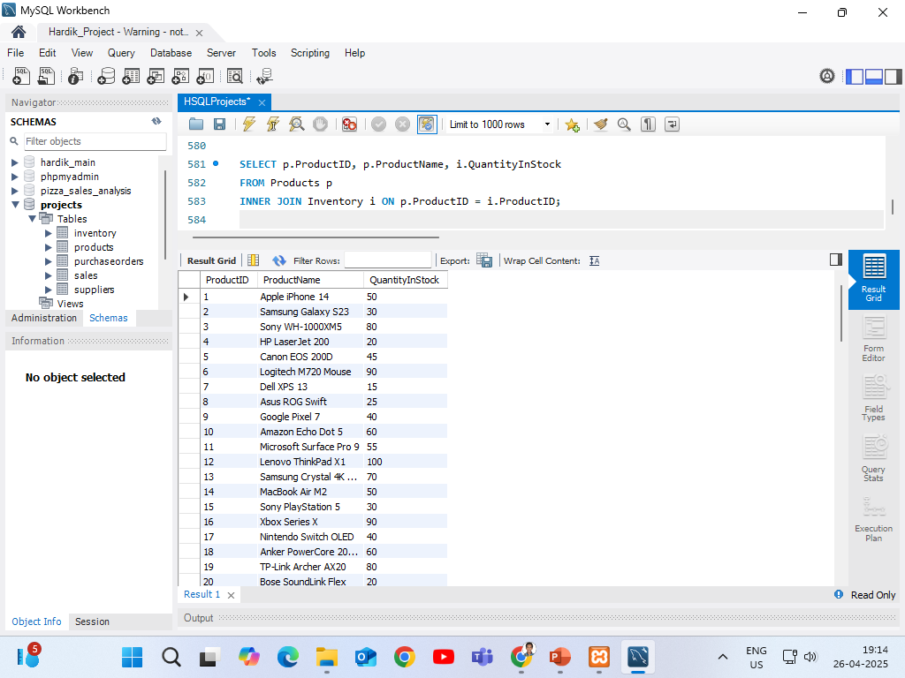
INNER JOIN to retrieve only products that are available in stock.
JOINS – 1 (INNER JOIN)
Match products and inventory for actively managed stock.

Slide 24
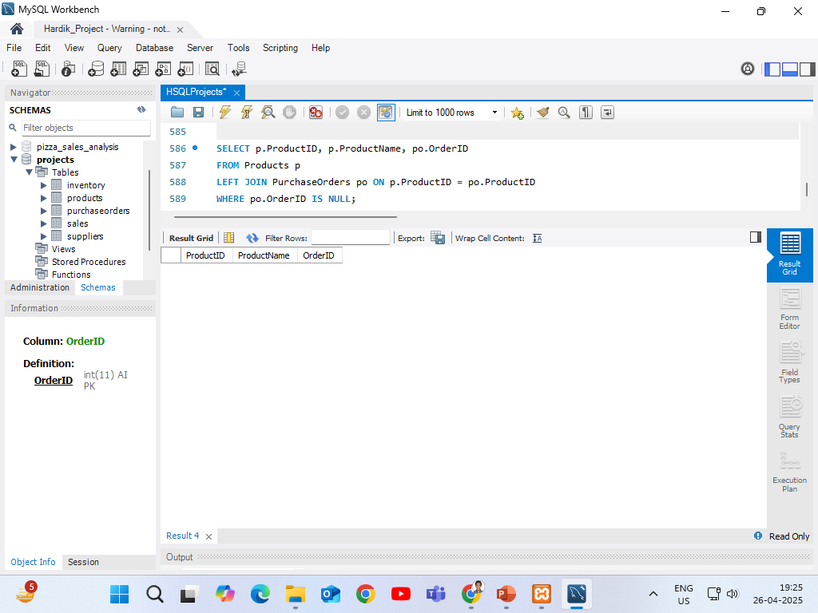
LEFT JOIN to find products that do not have any purchase orders yet.
JOINS – 2 (LEFT JOIN)
Lists products without any purchase orders.

Slide 25
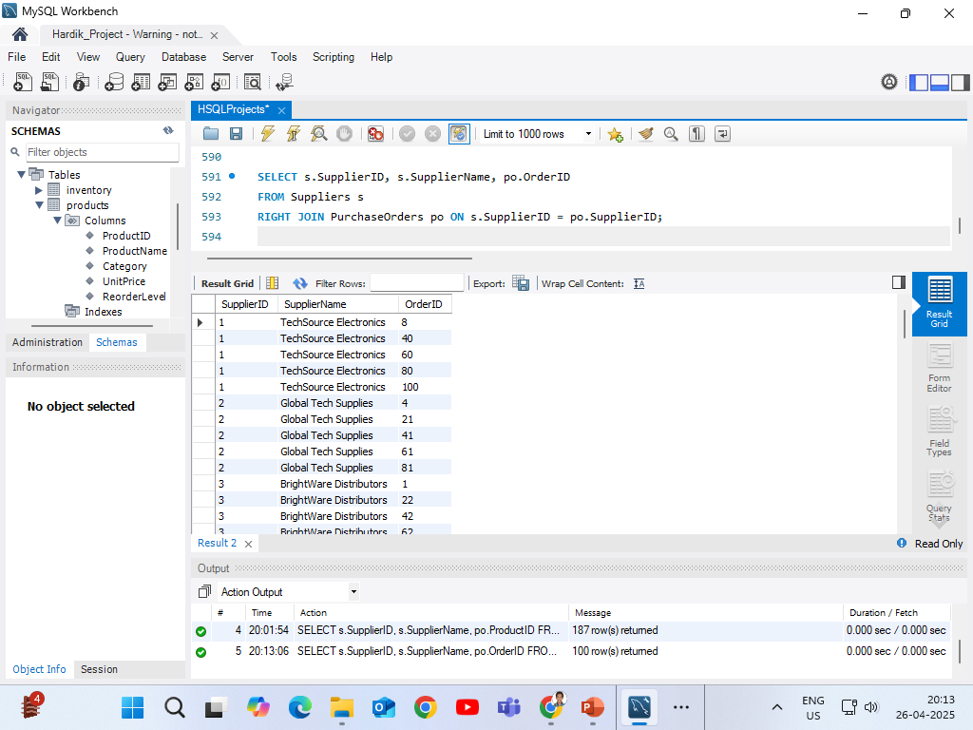
RIGHT JOIN to show all purchase orders, even if some suppliers information is missing.
JOINS – 3 (RIGHT JOIN)
Shows all purchase orders and their supplier details (if available).

Slide 26
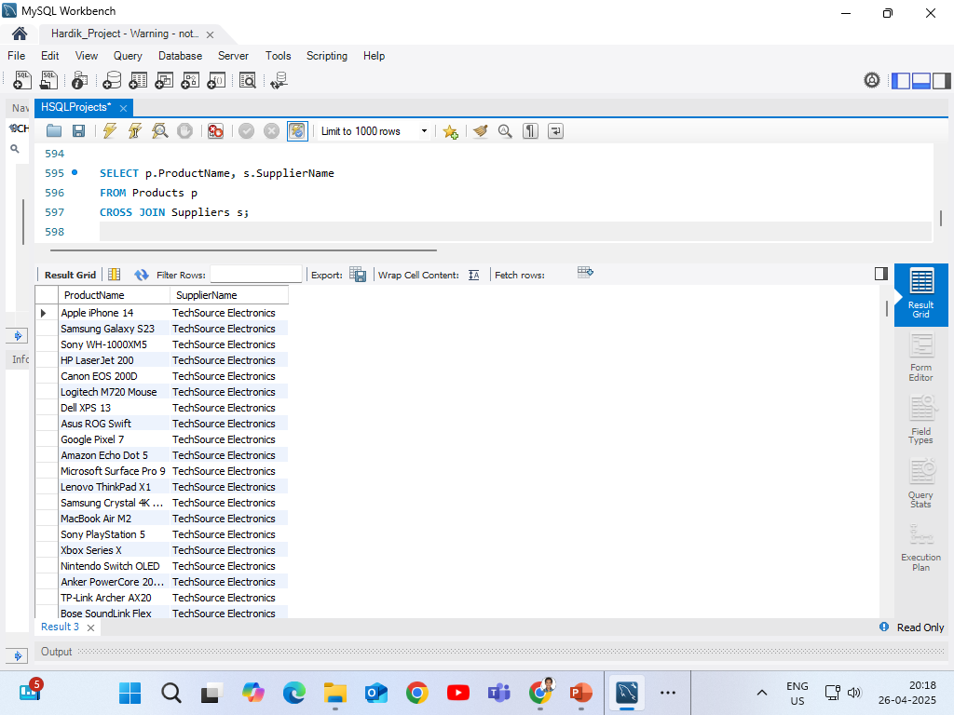
CROSS JOIN is used to create all possible combinations of products and suppliers, helping in planning future inventory or supplier partnerships.
JOINS – 4 (CROSS JOIN)
Lists every possible product-supplier combination.

Slide 27
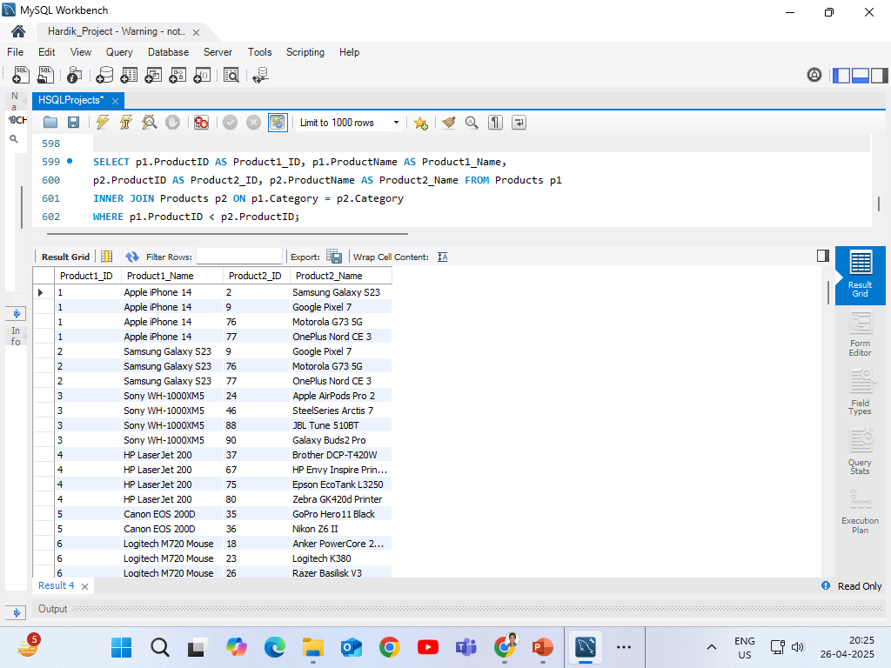
Self Join is used to compare products within the same category to identify similar items, helping in product bundling or category analysis.
JOINS – 5 (SELF JOIN)
To find and list products belonging to the same category for better inventory and marketing strategies.

Slide 28
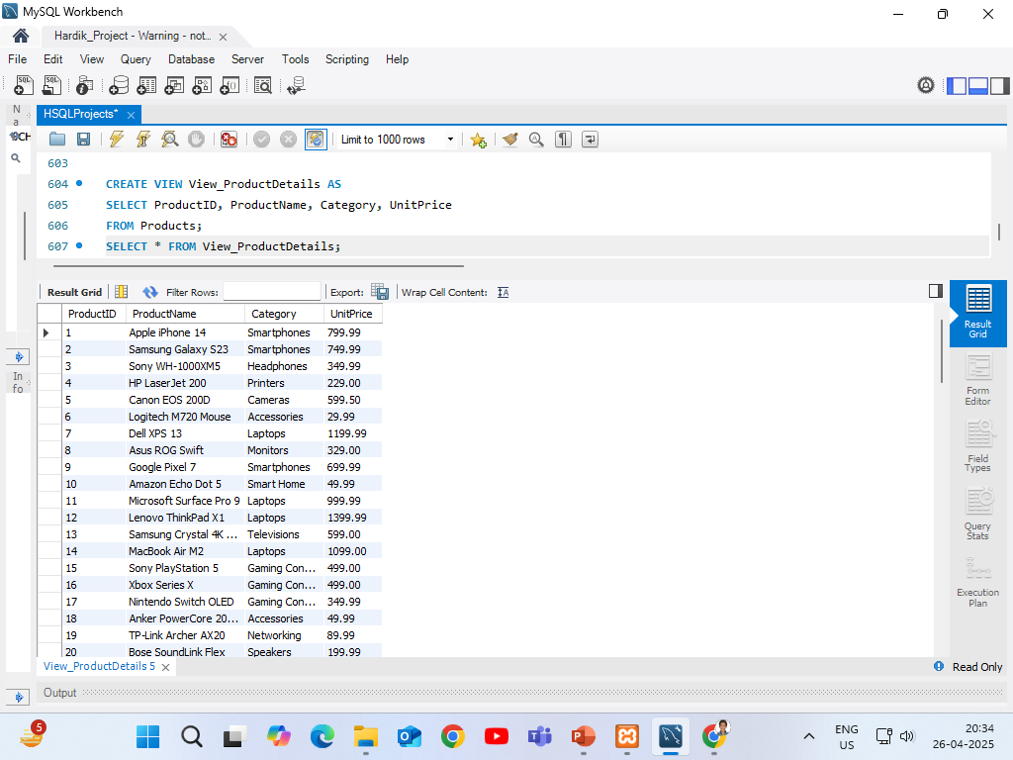
To quickly access basic product information without exposing full product table each time.
VIEWS – 1 (SIMPLE VIEW)
To simplify product lookup for reports and dashboards.

Slide 29
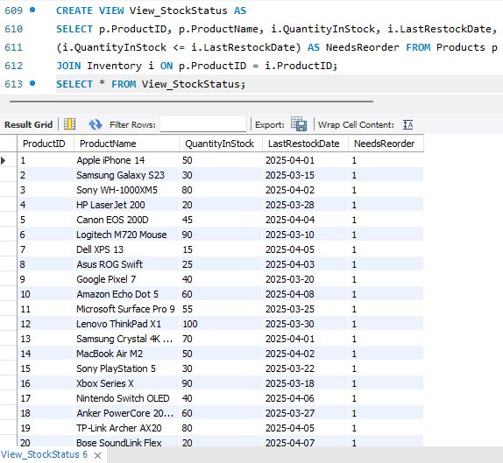
To combine product and inventory data and check automatically if reorder is needed.
VIEWS – 2 (COMPLEX VIEW)
To easily identify low-stock products needing replenishment.

Slide 30
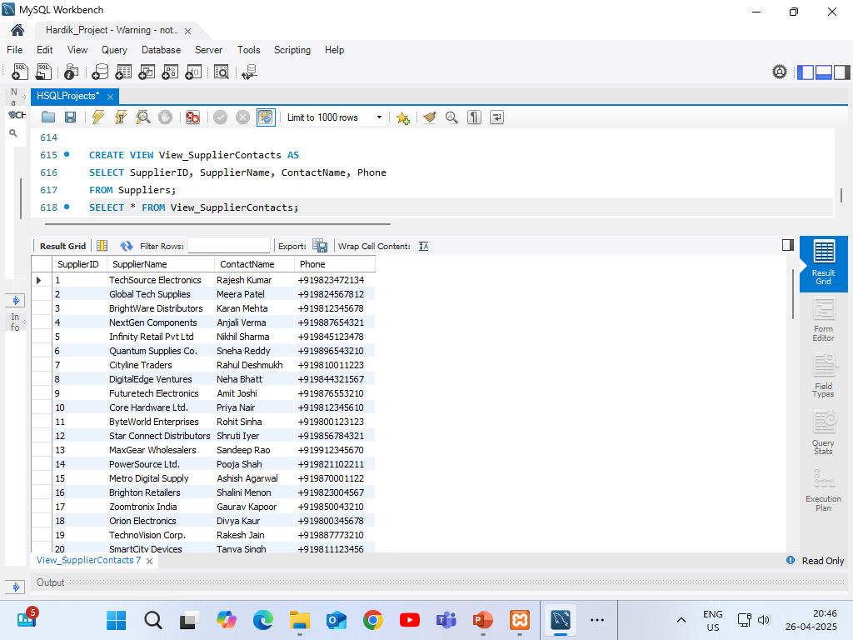
To create a focused, editable view for updating supplier contact details without accessing full supplier records.
VIEWS – 3 (UPDATABLE VIEW)
To allow safe updates to supplier contact information.

Slide 31
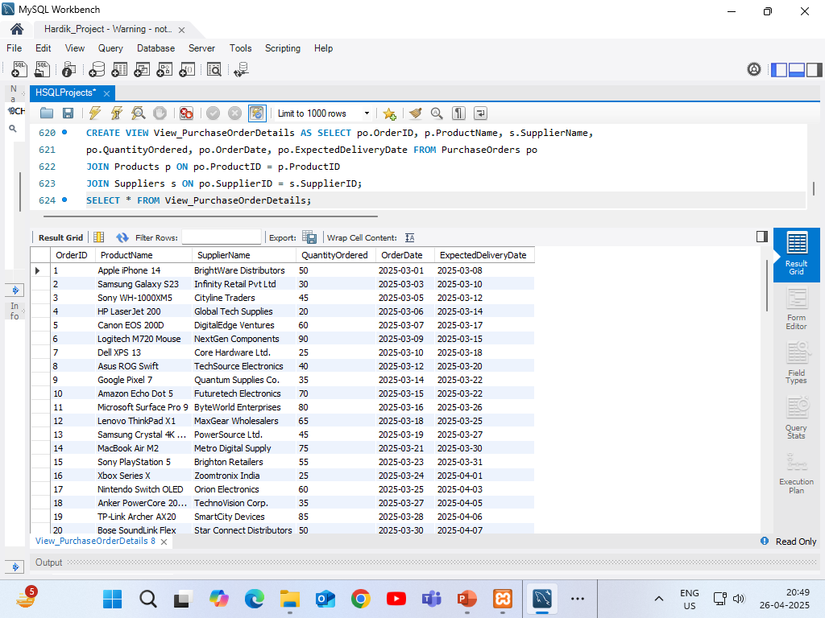
To combine purchase order data with product and supplier names for full procurement reporting — but non-updatable because of multiple tables join.
VIEWS – 4 (NON-UPDATABLE VIEW)
To prepare a detailed procurement report linking products, suppliers, and orders.

Slide 32
CONCLUSION
The project highlights the vital role of SQL in managing and analyzing inventory data within an Inventory Optimization System.
It starts with an overview of inventory management's importance, then explores key SQL concepts in detail.
Joins, subqueries, and views are used extensively to improve data retrieval, streamline analysis, and enhance reporting capabilities.
Practical case studies demonstrate how these SQL techniques help optimize inventory levels, cut costs, and boost operational efficiency.
The project emphasizes that a well-designed system using advanced SQL techniques is crucial for data-driven decision-making and successful inventory management.

Slide 33


